Slide 1
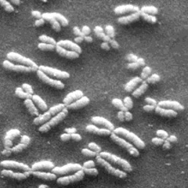
Punnett Squares: Part 2

Slide 2
Genes can be inherited based on various patterns
Mendel’s Dominance vs. Recessive
Incomplete dominance
Co-dominance
Multiple alleles
Multiple genes

Slide 3
Complete Dominance - Mendel
In this pattern one allele is designated DOMINANT while the other is recessive
It only takes the presence or absence of the dominant allele to determine the phenotype
There are only two possible phenotypes

Slide 4
Incomplete Dominance
In this pattern neither allele is considered recessive
Heterozygous conditions produce a blend of the two traits creating a third phenotype
Organisms with two different phenotypes produce offspring with a third phenotype that is a blending of the parents

Slide 5
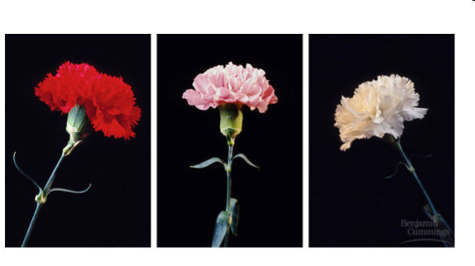
Example
In flowers, petal color demonstrates incomplete dominance. Red results when a flower has homozygous dominant alleles for the trait. White results when a flower has homozygous recessive alleles for the trait. A flower that is heterozygous for this trait will be pink.
Cross a Homozygous Red Flower and a Homozygous White Flower
R R
Rr | Rr
Rr | Rr
Genotypic Ratio: 100% Rr
Phenotypic Ratio: 100% pink flowers
r
r

Slide 6
Incomplete Dominance

Slide 7
Codominance
In this pattern much like incomplete dominance, neither allele is considered recessive
A cross between organisms with two different phenotypes produces offspring with a third phenotype in which both of the parental traits appear together.
Third phenotype will show both parental phenotypes simultaneously (at the same time)

Slide 8
Codominance
If you cross a red flower with a white flower:
RR X WW (Red X White)
R
R
RW Red/White | RW Red/White
RW Red/White | RW Red/White
R = allele for red flowers W = allele for white flowers
Red x White ---> red & white mixed RR x WW ---> 100% RW
W
W

Slide 9
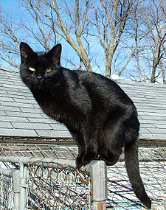
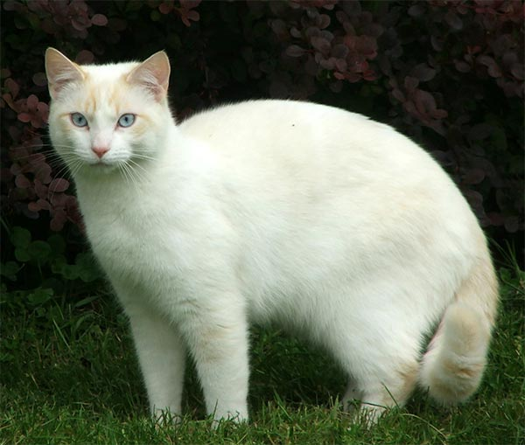
What is it?!
+
=
+
=

Slide 10
Multiple alleles
In this pattern there is more than just two alleles (3 or more)
Combinations of other patterns
Ex. Some alleles behave in a dominant/recessive fashion while other alleles display a co-dominant or incomplete dominant relationship
This can lead to multiple phenotypes
Blood type is controlled by three alleles. A, B, O
O is recessive, two O alleles must be present for the person to have type O blood
A and B are codominant. If a person receives an A allele and a B allele, their blood type is type AB

Slide 11
Blood type chart
PHENOTYPE | GENOTYPE
A | AA, I^{A}I^{A}
A | AO, I^{A}i
B | BB, I^{B}I^{B}
B | BO, I^{B}i
AB | AB, I^{A}I^{B}
O | OO, ii
I used with A and B
i used with O
A and B are dominant over O
A and B are codominant
Example:
Genotype: AA is I^{A}I^{A}
Blood type AB is an example of codominance in humans.

Slide 12
Blood Type Punnett Square
Draw a Punnett square showing all the possible genotypes for the offspring produced by a type “O” mother and a Type “AB” father.
i
i
Cross: ii x I^{A}I^{B}
I^{A}i | I^{A}i
I^{B}i | I^{B}i
I^{A}
I^{B}

Slide 13
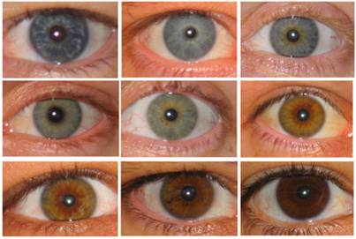
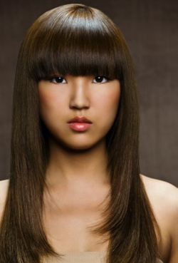
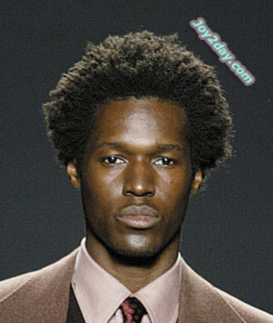
Multiple Genes: Polygenic traits
In this pattern, there is more than one gene responsible for a single trait.
Makes it possible for a wide range of genotypes and phenotypes.
Phenotype is produced by the interaction of more than one pair of alleles.

Slide 14
Determining offspring gender
Females have two X chromosomes.
Males have one X chromosome and one Y chromosome.
Every newborn has a 50% chance of being female and a 50% chance being male
Males determine the sex of the offspring. (Whether you get the X or Y from your dad determines your gender as you will always get an X from your mom.)
X
Y
XX | XY
XX | XY
X
X

Slide 15
Sex-Linked traits
The X chromosome contains many genes, whereas the Y chromosome contains only a few genes.
Sex-linked genes: genes located on one of the sex chromosomes (X or Y) but not the other.
Most sex-linked genes are X-linked genes.

Slide 16
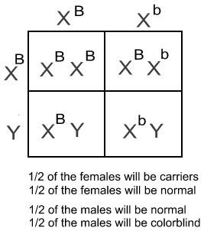
Examples of sex-linked traits: X-linked
Colorblindness: more common in males than females
Hemophilia: more common in males than females
Both Colorblindness and Hemophilia are recessive traits

