Slide 1
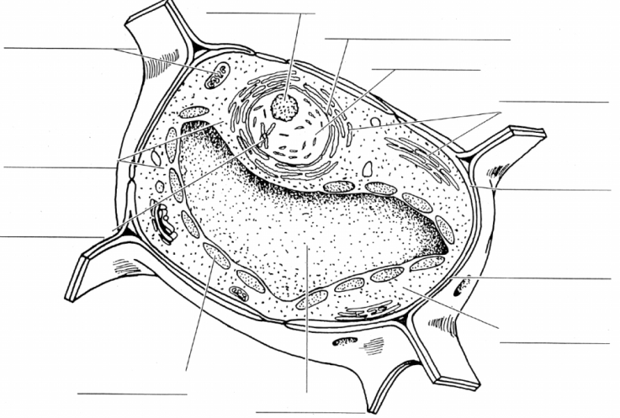
Station 1 – Plant Cells
Label each cell part/organelle.
Which organelles are found only in plant cells?

Slide 2
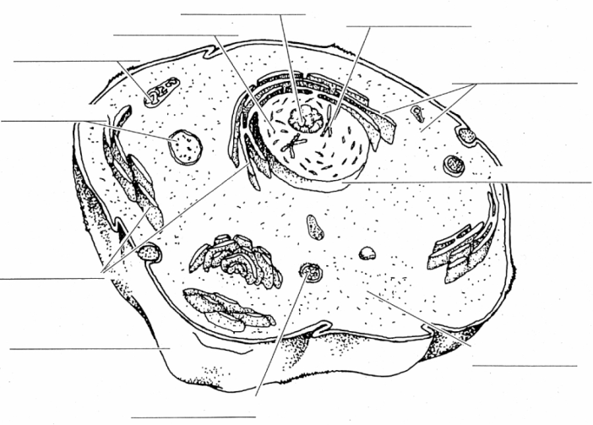
Station 2 – Animal Cells
Label each cell part/organelle.
Which organelles are found only in animal cells or are very different from the same structure when found in plant cells?

Slide 3
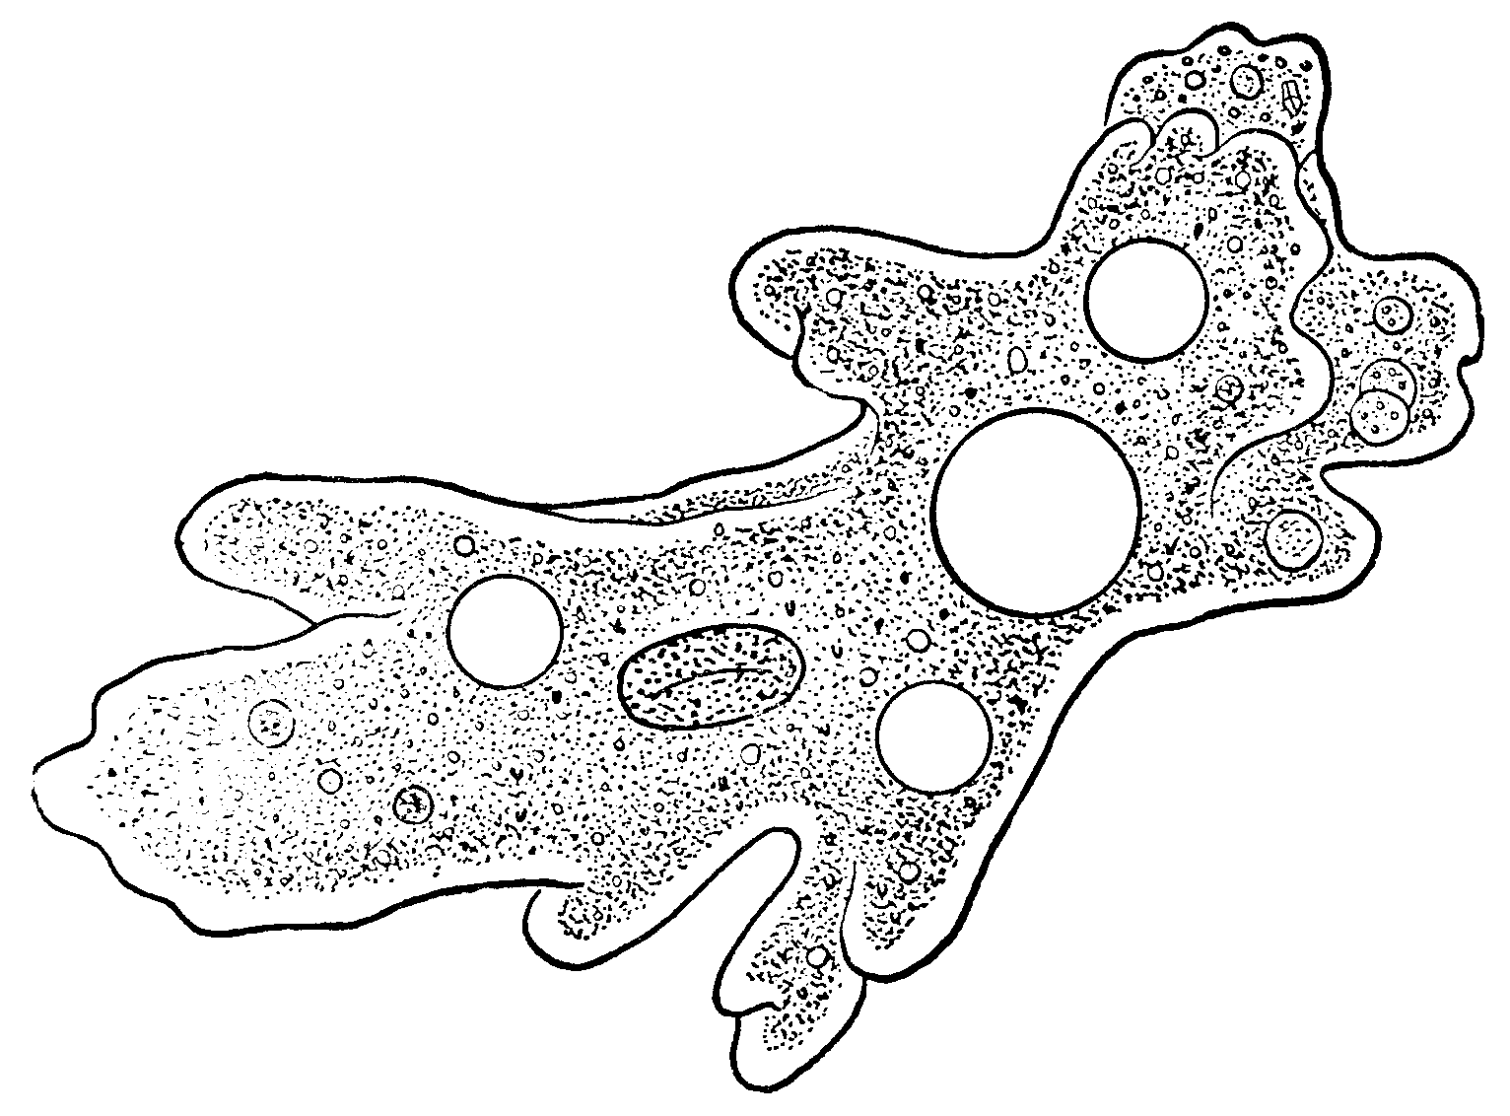
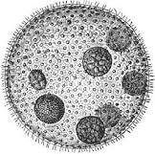
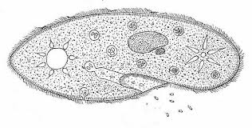
Station 3 - Protists
Identify each protist and their structure(s) used for movement.
Explain how each protist obtains food.
How does each protist reproduce?
Label each protist as plant-like, animal-like or both.
Label each of the protist diagrams with their structures.

Slide 4
Station 4 - Cells
What is the difference between eukaryotic and prokaryotic cells?
Give an example of each type of cell.
What is the difference between unicellular and multicellular ?
Give an example of each.

Slide 5
Station 5 – Cell Theory
Name the five scientists that contributed to our understanding of cells.
Identify the main contribution that each scientist made.
Write the three parts of the cell theory.

Slide 6
Station 6 – Characteristics of Living Things
1. - Identify the six characteristics of living
things (a-f).
- Provide an example of each characteristic.
2. Explain homeostasis and write an example of how living things maintain homeostasis.

Slide 7
Station 7 – Compare and Contrast
Make a double bubble map to compare and contrast plant cells and animal cells.

Slide 8
Station 8 – Quizizz
Login Google Classroom and complete the quizizz questions to review for the test. Use your REAL name when you login.

