Slide 1
Air Masses and Fronts REVIEW

Slide 2
Air Masses
All around the earth, large masses of air move around and constantly change the weather.
An air mass is a huge body of air that has similar temperature, humidity, and air pressure at any given height

Slide 3
Air Masses
Air masses are classified by 2 characteristics
Temperature
Humidity
The characteristics of an air mass depend on the temperatures and moisture content of the region over which the air mass formed.
Tropical: warm, air masses formed in the tropics
Polar: cold, air masses form near north or south pole
Maritime: air masses formed on oceans or seas
Continental: air masses formed over land

Slide 4
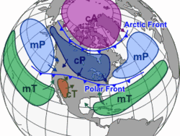
The colder the air, the higher the air pressure, subsequently, the hotter the air, the lower the air pressure.
Cold air → more dense
Hot air → less dense
There are 4 major types of air masses that affect the weather of the U.S.
Maritime tropical
Maritime polar
Continental tropical
Continental polar

Slide 5
North American Air Masses

Slide 6
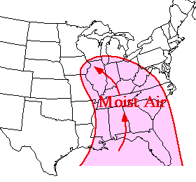
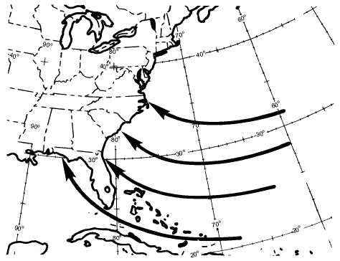
Maritime tropical
Warm, wet air masses
On the east coast they are formed over the Gulf of Mexico & south Atlantic Ocean.
Influence weather along the entire east coast.
Summer: thunderstorms & summer showers
Winter: heavy snow or rain
On the west coast they form over the southern Pacific Ocean.

Slide 7
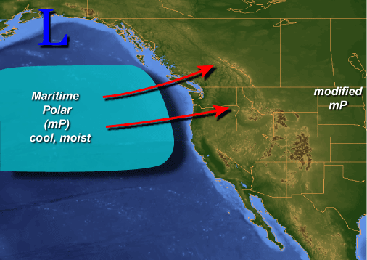
Maritime polar
Cold, wet air masses
On the east coast they are formed over the north Atlantic Ocean.
On the west coast they are formed over the north Pacific Ocean.
Influence the weather of the west coast more so than that of the east coast.
Summer/Winter: fog, rain, & cooler temperatures

Slide 8
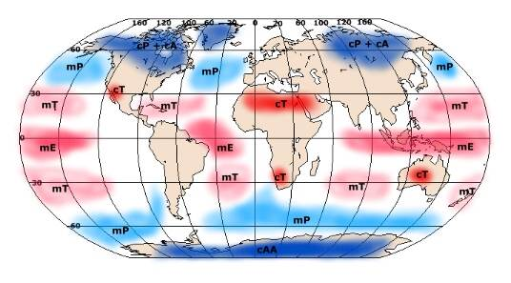
Continental tropical
Warm, dry air masses
Typically form over the southwest (New Mexico, Arizona, Nevada, as well as northern Mexico) during the summer months.
Influence the weather of the southwestern part of the US & southern Great Plains (Kansas, Oklahoma, Texas, Iowa).
Summer: Hot, dry

Slide 9
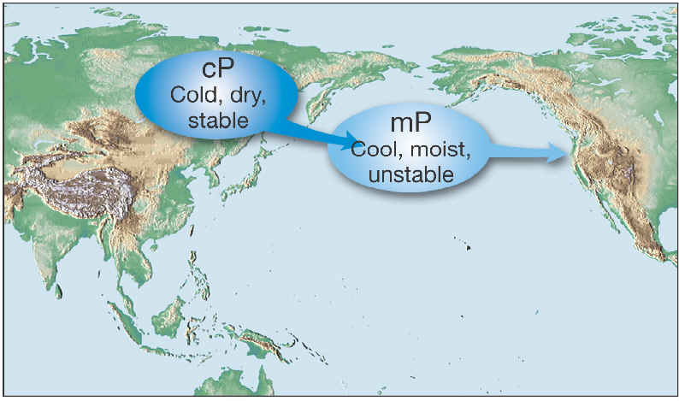
Continental polar
Cold, dry air masses
Typically form over central & northern Canada as well as Alaska.
Influence the weather of the entire United States.
Winter: Clear, cold, dry
Summer: Potential for storms due to interaction with Maritime tropical air moving up from the Gulf of Mexico.

Slide 10
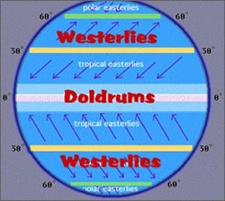
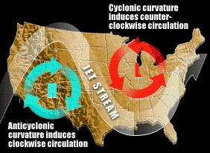
2 primary methods for air mass movement
Prevailing Westerlies
Pushes air masses from west to east.
Jet streams
Pushes fast moving air masses from west to east.

Slide 11
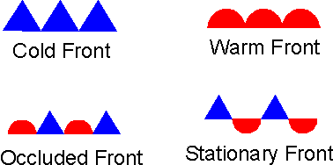
Fronts
The boundary between two air masses.
Air masses do not easily mix with each other due to the differences in…
Density (Air pressure)
Temperature
Moisture content
Storms & different types of weather phenomena occur along fronts.

Slide 12
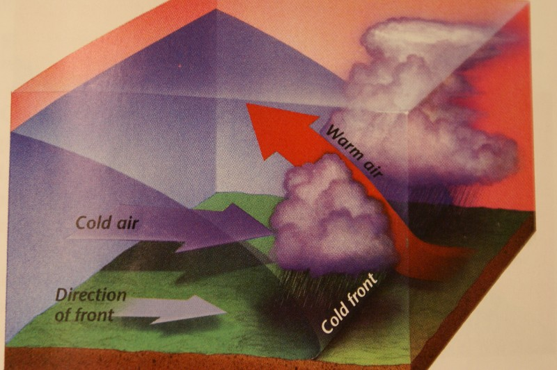
Fronts
Cold front
Fast moving cold air mass overtakes a slower moving warm air mass.
Can cause abrupt weather changes particularly thunderstorms.
Clear skies, a change in wind, & lower temperatures usually follow a cold front.

Slide 13
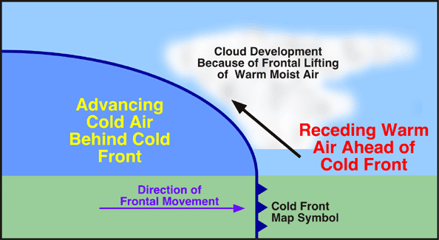

Slide 14
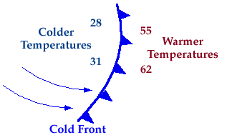
On weather maps, cold fronts are represented as a line of triangles.
The triangles are often colored blue or green (cooler colors), with the point of the triangle signifying the direction of movement.

Slide 15
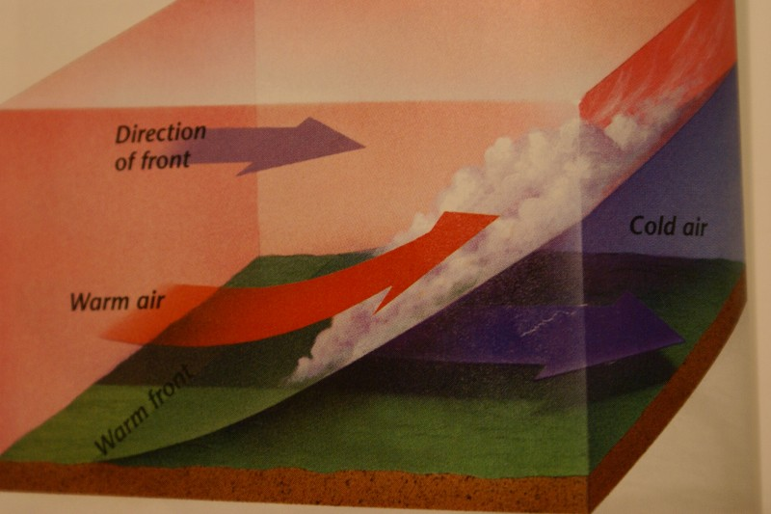
Warm front
A fast moving warm air mass overtakes a slow moving cold air mass.
Can cause extended periods of rainy or cloudy weather.
Warm, humid weather usually follows a warm front.

Slide 16
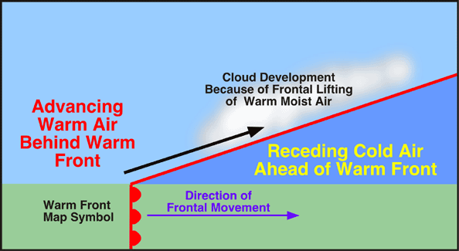

Slide 17
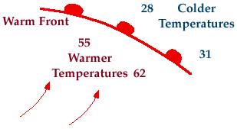
Warm fronts appear on the weather map as a line of semi-circles (often red in color), with movement signaled by the leading edge of the circle.

Slide 18
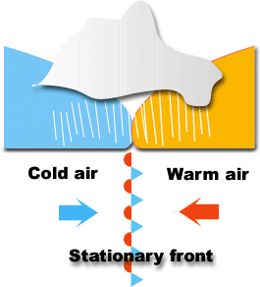
Stationary front
A cold air mass and a warm air mass meet but neither can move the other.
Can cause extended periods of precipitation; snow, rain, fog or clouds.
Cold fronts often “stall” along the coast of North Carolina as they lose energy.
Eventually, a new air mass will move in and replace the stationary front.

Slide 19
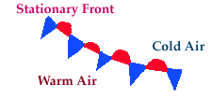
Stationary fronts appear on the map as a line of alternating triangles and semi-circles that face in opposite directions.

Slide 20
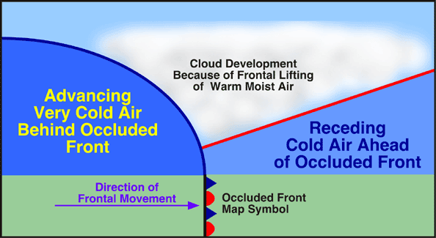
4. Occluded front
A warm air mass is caught between 2 cooler air masses.
The denser cold air forces itself under the existing warm air causing heavier amounts of precipitation to fall (inches of rain or snow).
Due to the hybrid nature of the occluded front, weather patterns at the beginning of its formation are similar to those of a warm front.

Slide 21
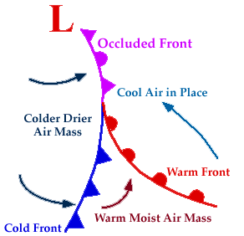
Occluded fronts appear as a line of alternating triangles and semicircles facing the same direction.

Slide 22
Pressure Systems
Air always flows from areas of high pressure to areas of low pressure
Due to the Coriolis effect, it does not flow in a straight line.
The winds form a spiral:
inwards and upwards in low pressure systems,
downwards and outwards in high pressure systems.

Slide 23
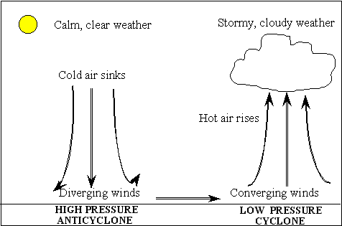
High Pressure
High Pressure – region of the greatest atmospheric pressure.
Represented on weather maps by an H.
Cold air sinks and spins around the center in a clockwise rotation termed “anti-cyclonic.”
Accompanied by dry weather and clear skies.

Slide 24
Low Pressure
Low Pressure – region of the lowest atmospheric pressure.
Represented on weather maps by an L.
Caused as the boundary between fronts become distorted by surface features; mountains or strong winds.
Warm air rises and spins in a counter-clockwise motion termed “cyclonic.”
Storms and precipitation are associated with areas of low pressure.

Slide 25
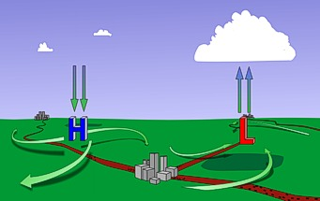
Low Pressure and Fronts Cause Lift

